Slide 1
Epistemology and Ethics of Business Analytics MOT1442 Q2
Dr Jack Casey

Slide 2
Logistics
Exam on the 12th
Even if you aren’t registered, still attend, we should be able to seat you.

Slide 3
Scientific Realism and Anti-Realism
My aim today: to convince you that believing our best scientific theories are not actually true is not a ridiculous position to take!

Slide 4
Structure of the Lecture
We’ll examine two general arguments for and against scientific realism and scientific anti-realism
We’ll then look at more refined accounts of scientific realism and anti-realism
The accounts we’ll look at: entity realism, structural realism, constructive empiricism, and instrumentalism
Finally, we’ll consider a possible argument from anti-realism that comes from machine-learning algorithms
Main aim is for you to understand these two main arguments, and to have a broad overview of these four main positions.

Slide 5
Scientific Realism and Anti-Realism
Central question we’re considering today: When we consider our best, most predictively successful scientific theories (quantum mechanics, relativistic mechanics, etc.), should we believe that those theories are (approximately) true?

Slide 6
Scientific Realism and Anti-Realism
Note before we begin: we’re not concerned here with older, obviously false theories (think geocentric model of the solar system).
We’re talking about our best, cutting-edge, most empirically supported theories, in all branches of science (think quantum field theory, relativistic mechanics, germ theory, genetics, etc.)

Slide 7
Scientific Realism and Anti-Realism
Central question rephrased: Our best scientific theories posit electrons. Should we believe that electrons actually exist?

Slide 8
Scientific Realism
You might think, obviously we should.
In which case, you’re a scientific realist.
Scientific realism (broadly construed) says that scientific theories are (approximately) true.
In doing so, we commit ourselves to the existence of the entities those scientific theories posit (electrons, DNA, gravitational waves, etc.).

Slide 9
Scientific Realism
Why does this commit us to those entities?
Well, take the sentence ‘the chair is red’
If that sentence is true, then the chair must exist, and it must be red
So too, then, committing to the truth of scientific theories that state that certain entities have certain properties, commits us to the existence of those entities

Slide 10
Scientific Realism
Our main concern, here, is the ontological commitments entailed by scientific theories
Ontology = the study of what there is, in the most general sense

Slide 11
No Miracles Argument (NMA)
Why be a scientific realist then?
Reasoning along the following lines won’t work:
Of course electrons exist! If anything is true, our best scientific theories are, and if they require us to believe in those entities they posit, we should believe in them.
This is simply begging the question (we’re assuming the truth of our best scientific theories and arguing for their truth on that basis).
We need a stronger argument for realism

Slide 12
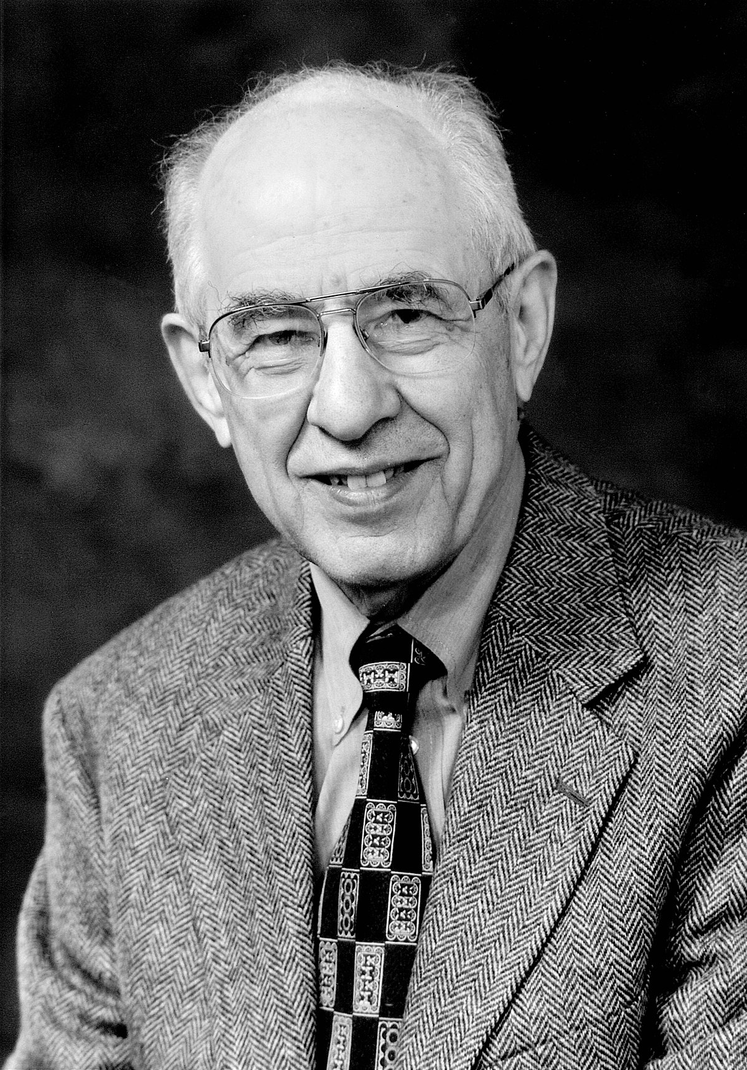
No Miracles Argument (NMA)
The most popular argument for realism is the no miracles argument
First formulated by Hilary Putnam (1975)
Argument goes like this:
Our best theories are extraordinarily successful. They make empirical predictions, and often do so with astounding accuracy. What explains this? The only way that success is not miraculous is if those theories are (approximately) true.

Slide 13
No Miracles Argument (NMA)
We should believe scientific theories are true, then, because if they weren’t, their success is miraculous.
It’s an inference to the best explanation
Vast literature on whether or not this is a valid inference, and vast literature refining it.
For our purposes, the basic version will do.

Slide 14
Scientific Anti-Realism
Alternatively, you might think that our best scientific theories are not true.
If you agree with this position, you’re a scientific anti-realist

Slide 15
Pessimistic Meta Induction (PMI)
Why be a scientific anti-realist, then?
There’s one particularly persuasive argument for scientific anti-realism
This argument is often called the pessimistic meta induction
Fancy sounding name, but very easy to understand
Basic idea: scientific theories are constantly supplanted
Attributed to Larry Laudan (1981)

Slide 16
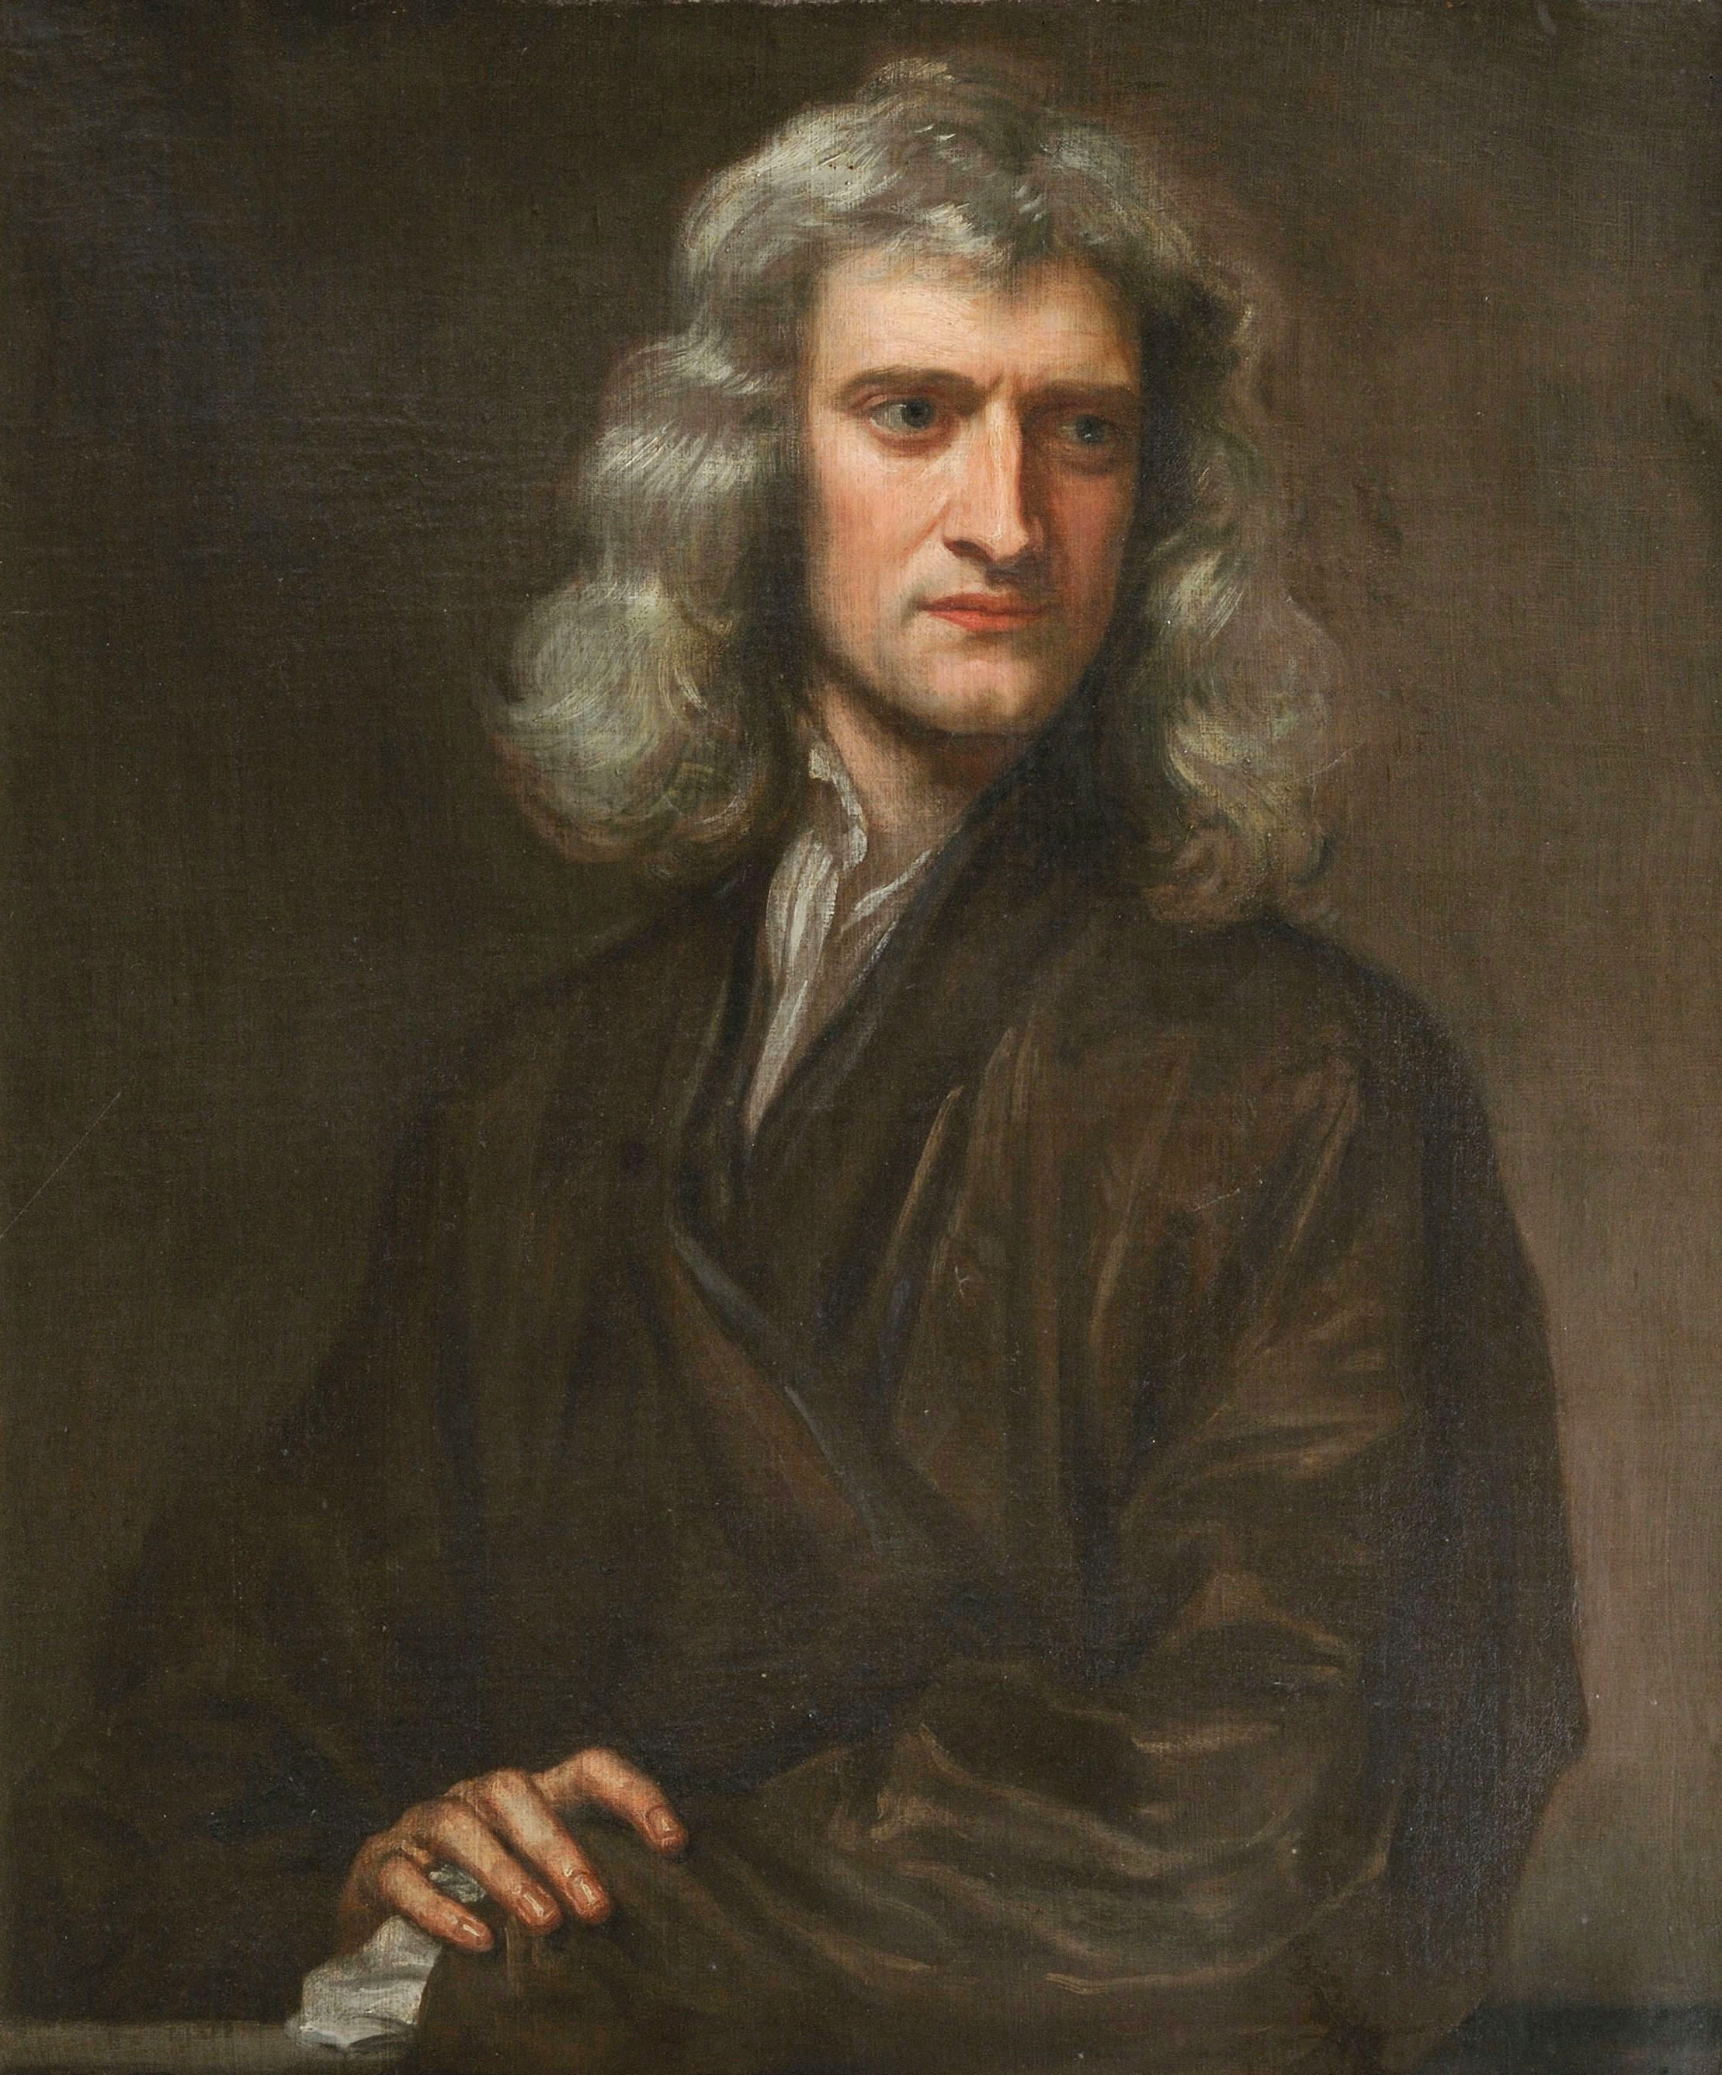
Pessimistic Meta Induction (PMI)
Take the example of Newtonian Mechanics
Extraordinarily predictively successful theory
Allowed us to predict the motion of bodies in the solar system, for example
Still used by engineers and physicists to this day
Nature and nature's laws lay hid in night: God said, Let Newton be! and all was light. —Alexander Pope, "Epigram on Sir Isaac Newton"

Slide 17
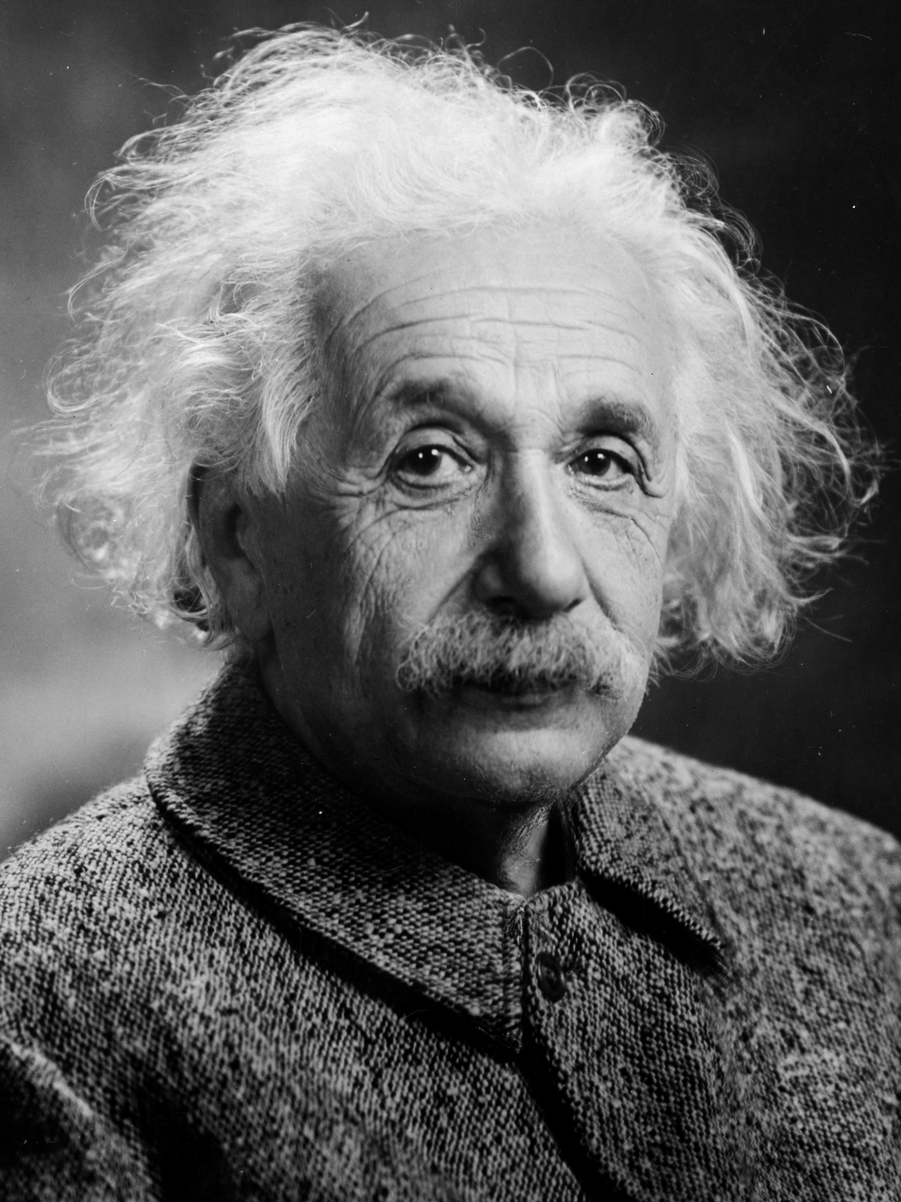
Pessimistic Meta Induction (PMI)
Problems lurked for Newtonian Mechanics
For bodies that are extremely massive, extremely small, or travel at speeds approaching speed of light, the theory’s predictions are inaccurate
Along comes Einstein with his General Theory of Relativity, which 1) made the same predictions that Newtonian Mechanics makes within its applicable domain, and 2) extends that, such that it accurately predicts the behaviours of bodies that Newtonian Mechanics failed to capture
Importantly, Einstein’s theory was incommensurable with Newton’s – it wasn’t a refinement of classical mechanics. It was a fundamentally different theory, and only one of them could be true.
Nature and nature's laws lay hid in night: God said, Let Newton be! and all was light. —Alexander Pope, "Epigram on Sir Isaac Newton" It did not last: the Devil howling "Ho! Let Einstein be!" restored the status quo. —J. C. Squire (1884-1958), "Answer to Pope's Epitaph for Sir Isaac Newton"

Slide 18
Pessimistic Meta Induction (PMI)
What does this tell us then?
This phenomenon is observed throughout science
Even highly predictively successful theories are constantly supplanted by better ones
Newer theories don’t gradually refine older ones, they are incompatible
This is not a process of evolution, but revolution*
Predictive success, then, is no guarantee of truth – contra to the NMA
On this basis, we make the inductive inference that our current theories are likely to be supplanted in the future
Therefore, our best scientific theories are also unlikely to be true
We should therefore be anti-realists
*(see: Thomas Kuhn, The Structure of Scientific Revolutions, 1962)

Slide 19
Pessimistic Meta Induction (PMI)
Quick note: name should make sense now
Meta induction, in so far as it’s an inductive inference about the inductive inferences we make at the level of scientific enquiry
Pessimistic, in so far as it’s not hopeful with regards to any given theory’s chances of not being supplanted

Slide 20
Overview (NMA & PMI)
We have two forceful arguments, then, in the no miracles argument, and the pessimistic meta-induction
Both point in opposite directions
NMA for realism, against anti-realism
PMI for anti-realism, against realism
The arguments do seem fairly devastating to the naïve statements of either position
Various refinements of realism and anti-realism have been offered that attempt to avoid the thrust of the respective opposing argument

Slide 21
Realism and anti-realism
We’ll look at two more nuanced versions of realism:
Entity realism
Structural realism
We’ll also look at two versions of anti-realism:
Constructive empiricism
Instrumentalism

Slide 22
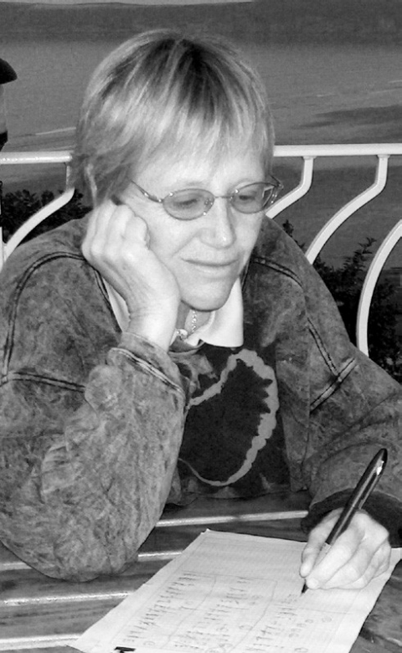
Entity Realism
Nancy Cartwright (1983), and Ian Hacking (1983).
Michela Massimi another notable contemporary proponent (of a slightly different version)
Rough idea is: we can justifiably believe some entities exist without also committing ourselves to any particular theory in which those entities are embedded
We know electrons exist, even if we’re sceptical about the theories about those electrons
Some intuitive pull; my belief in chairs isn’t predicated on my belief in any particular theory!
Ian Hacking, referring to experiment where electrons were sprayed onto a superconducting metal sphere:
‘So far as I’m concerned, If you can spray them, then they are real.’

Slide 23
Entity Realism
We are realists about entities, but not about theories (i.e., anti-realists about laws)
Paraphrase of an argument from Nancy Cartwright (1983)
Gravity acts on a particle, but so too does the electromagnetic force
All these forces add vectorially to produce a resultant force and a resultant acceleration of the particle
The accelerations due to each separate force do not appear to occur, as a result (imagine the particle is drawn to some point by gravity, but repelled from that point by electromagnetism – easy to imagine that both forces are cancelled out, for example)
Strictly speaking, then, what the laws say is false (the particle isn’t drawn to the point by gravity, and the particle isn’t repelled from the point by electromagnetism)
Cartwright’s position, then, is that laws are strictly speaking false
Furthermore, either the resultant force is real, or the components (gravity and electromagnetism) are. If it’s both, then we’d get twice the resultant force!
So, only the resultant force is real, but that force isn’t described a fundamental law, so the fundamental laws are false
So, since they are false, we should be anti-realist about the laws of physics

Slide 24
Entity Realism
So, it’s anti-realist about laws (hence, isn’t subject to the PMI)
What is it realist about? Entities
‘…the electron is not an entity of any particular theory… about which we have a large number of incomplete and competing theories’ (Cartwright, 1983: pg. 92)
What we can be sure about, according to Cartwright, is that theories provide us with good explanations
An explanation that appeals to electrons ‘makes no sense at all without the direct implication that there are electrons’ (pg. 92).
Therefore, electrons exist.

Slide 25
Entity Realism - Problems
Hard to see how Entity Realism really avoids the PMI
If an explanation is successful because it posits electrons, and therefore we should be realists about electrons, why not be realists about the forces, as well?
If they’re false, as Cartwright argues, then why believe in electrons either?
There are also forces that are not ceteris paribus (i.e., apply all alse being equal, as in the classical case we saw). Some are true tout court. For example, Pauli exclusion principle. Cartwright’s argument fails to apply to those laws.

Slide 26
Entity Realism - Problems
The distinction between being realist about entities and being realist about theories is misconceived. It may well be the case that electrons exist, even though some (or most) of our descriptions associated with the term ‘electron’ are false. But the issue at stake is different. It is this: can we assert that electrons are real, i.e. that such entities exist as part and parcel of the furniture of the world, without also asserting that they have some of the properties attributed to them by our best scientific theories? I take it that the two assertions stand or fall together.
(Stathis Psillos, 1999: 248)

Slide 27
Structural Realism
John Worrall (1989), Steven French, and James Ladyman
What is retained through theory change? Structure!
Mathematical structure of theories is preserved across theory change, even if the ontological pictures are entirely different

Slide 28
Structural Realism
Famous example is Fresnel’s theory of light, and Maxwell’s theory of electromagnetism
Fresnel posited that light was the propagation of waves through an ether. Maxwell, instead, suggests that light is disturbance in an electromagnetic field.
Though they posit fundamentally different entities, in terms of the mathematical formalism, there is preservation between theories.

Slide 29
Structural Realism
…his object [Fresnel] was to predict optical phenomena. This Fresnel’s theory enables us to do today as well as it did before Maxwell's time. The differential equations are always true, they may be always integrated by the same methods, and the results of this integration still preserve their value. (Poincare, 1905)
Fresnel entirely misidentified the nature of light, his theory accurately described not just light's observable effects but its structure. There is no elastic solid ether. There is, however, from the later point of view, a (disembodied) electromagnetic field. The field in no clear sense approximates the ether, but disturbances in it do obey formally similar laws to those obeyed by elastic disturbances. (Worrall, 1989: 118)

Slide 30
Structural Realism
Rather than commit to the entities that is preserved across theory change, we commit to the preservation of structure.
Avoids PMI, and accedes to NMA
At this point, we can ask: what are we committing to?
Structural realism bisects on this issue.
Epistemic Structural Realism (ESR) says: the mathematical structure identifies relations between entities. It’s those relations we commit to the existence of.
Ontic Structural Realism (OSR) says: something much more mysterious! Structure is the only ontologically real entity – our conception of the world as being constituted by entities is mistaken. There are no such things, and if there are, they (or impressions of them) “emerge” from the structure we identify in our theories.

Slide 31
Structural Realism
Problems with structural realism:
If we’re epistemic structural realists; if mathematical formalism identifies relations, and that formalism identifies relations, then what stands in those relations? Take the relation of marriage – if you think the relation exists, then you necessarily also think people exist (how could we say there is an instance of a relation of marriage, without people to stand in that relation? Does that even make sense?). It seems to collapse into traditional entity realism.
If we’re ontic structural realists; what exactly is it that we’re supposed to commit to? It’s not clear what the candidate for the worldly equivalent of the mathematical formalism that we take ‘structure’ to be, if it’s not entities as traditionally conceived. Furthermore, even given some satisfactory account of what it is, why do we experience the world as one populated by entities, and not by structure?

Slide 32
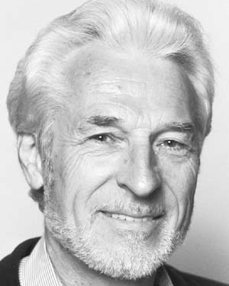
Constructive Empiricism
Bas van Fraasen (1980)
‘Science is red in tooth and claw’
Landscape is littered with dead theories that weren’t predictively successful
In this sense, they’re subject to evolutionary pressures (only the predictively successful survive)
Those that remain aren’t necessarily true, they’re just the ones that survived scrutiny

Slide 33
Constructive Empiricism
Surviving scientific theories are not true, but empirically adequate
Constructive empiricism divides the world into the observable, and the unobservable.
A theory is empirically adequate iff what it says about observable phenomena is indeed the case
Where exactly this line is, between observable and unobservable, is up for debate
Rough idea: macroscopic features observable, microscopic unobservable (exceptions apply – what about black holes, for example?)

Slide 34
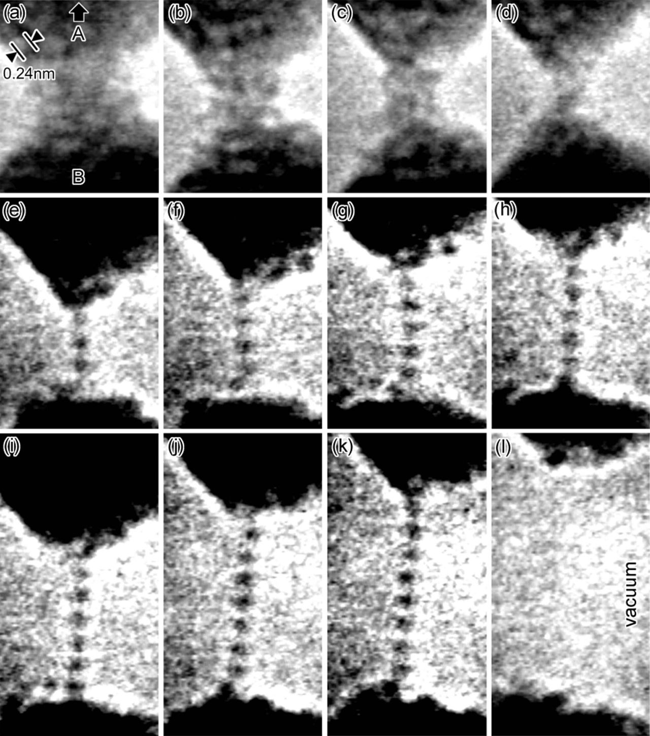
Constructive Empiricism
If we take the example of gold
We know a lot about the macroscopic features of gold – we know it’s texture, what it feels like, what it looks like, etc.
The scientific realist says that we know a lot about its microscopic features, too – that it has atomic number 79, how many electrons it has per shell, etc.
The constructive empiricist takes the macroscopic features of gold to be observable, and the microscopic features that are only understood by mediation of a theory as being unobservable.

Slide 35
Constructive Empiricism
Both the realist, and the constructive empiricist, agree that it's true that gold is unreactive
The realist would say that gold is unreactive because it is true that its outermost shell is full of electrons.
The constructure empiricist says: all we know for sure is, at the macroscopic level, gold is unreactive (it doesn’t rust, for example). The best theory about why this is concerns unobservables; it’s empirically adequate in so far as it entails that, at the macroscopic level, gold is unreactive, and we observe that to be true. What we shouldn’t say is that the theory is true.

Slide 36
Constructive Empiricism
Why? Well, the theory concerns unobservables – we have no way of empirically verifying the claims. The only means we have of doing so are themselves mediated by the theory.
Take the picture in the top right, though it seems compelling evidence of the atomic structure of gold, the image is produced by a scanning electron microscope – in some sense, we have to assume the truth of the theory to even consider the picture as evidence.

Slide 37
Constructive Empiricism
Constructive empiricism is an epistemically conservative position, then.
Don’t say theories are true, just say they are empirically adequate!
In doing so, you’re not committed to the existence of any unobservable entities – and as the PMI has shown, a lot of these fall by the wayside (caloric theory of heat, phlogiston theory, corpuscular theory of light, etc.)

Slide 38
Constructive Empiricism
Problems
Is there any way to distinguish between observables and unobservables non-arbitrarily?
If all humans suddenly went blind, suddenly a lot of what was observable might now be unobservable!
Blackburn argues that a scientist treating a theory as empirically adequate is no different from one that treats it as true – and thus the position collapses into realism, anyway.
Doesn’t seem to escape the NMA (though van Fraassen elsewhere attacks the argument on other grounds)

Slide 39
Instrumentalism
The strongest form of anti-realism is instrumentalism, or pragmatism
Don’t just deny the truth of theoretical statements concerning unobservables -- deny the literal truth of statements concerning observables, as well

Slide 40
Instrumentalism
Much more radical position
Same conservative epistemic attitude as constructive empiricism
They claim that we have no good reason to think that scientific theories are true because they are predictively successful
On what basis do realists make this inference? We have no prior experience of a predictively successful theory being true – to claim otherwise would be to beg the question against the anti-realist!

Slide 41
Instrumentalism
As with constructive empiricism, disregard the idea that science’s aim is truth – science’s aim is (or should be) predictive success
One problem: if we’re no longer willing to accept even observable statements as true, how can we assess whether or not a theory is predictively successful?

Slide 42
Instrumentalism
We can understand the notion of truth pragmatically – what it is for something to be true is determined pragmatically
Any idea upon which we can ride, so to speak; any idea that will carry us prosperously from any one part of our experience to any other part, linking things satisfactorily, working securely, simplifying, saving labor; is true for just so much, true in so far forth, true instrumentally. This is the ‘instrumental’ view of truth. (William James, 1907 [1975: 34])

Slide 43
Instrumentalism
On this position, then, our best scientific theories are indeed true (where true is understood in this pragmatic sense) – they are those that are maximally useful to us!
This would still be anti-realist, but structurally seems to resemble the realist position which we started with!

Slide 44
Instrumentalism
The realist and instrumentalist might actually agree as to what our best theories are; our most empirically supported theories of physics, for example, are likely to be the most useful, given their general applicability (in so far as they describe all physical phenomena)

Slide 45
Instrumentalism
They differ, in so far as the realist offers an explanation for why they are useful. The instrumentalist refuses to engage with the question.
For instrumentalists, any “transcendental” connection between matters of fact and statements about them, is of no interest – hence, this pragmatic theory of truth
Statements are not true because they correspond with reality in some mysterious sense, but because they are useful
Think of beliefs you take to be true – you deduce things from them, you can plan things on the basis of them, you can make predictions with them. You can’t do that false beliefs. Perhaps that’s all there is to a belief being true.

Slide 46
Instrumentalism
So, very radical indeed.
Requires us to understand truth pragmatically.
Once we do so, however, seems plain as to why some theories are better than others – essentially, they’re more predictively successful (and so are more useful).
Can even explain why they’re predictively successful in some sense – because they’re true in a pragmatic sense!
‘If we were to reach a stage where we could no longer improve upon a belief, there is no point in withholding the title “true” from it.’ (Misak 2000: 101

Slide 47
Argument from AI
Having considered some of the main positions within the debate between realism and anti-realism, we’ll now finally turn to an argument for anti-realism that comes from machine learning.

Slide 48
Argument from AI
Machine learning algorithms, at their core, pick out patterns.
Oftentimes, it picks out patterns too subtle for humans to detect.
One example: machine learning algorithms were trained to recognise structural features in antibiotic chemicals.
Those algorithms were then given a large dataset of molecules whose antibiotic qualities were unknown.
The machine learning algorithm picked out one molecule that was more closely related to anti-fungal medications. The molecule was named Halicin.
Because it was chemically different from most antibiotics we’ve identified, it has an unusual mechanism of action – as a result, it is likely to be effective against a number of drug-resistant bacteria.
In vivo studies have confirmed its efficacy

Slide 49
Argument from AI
What does this example tell us, then:
It seems possible to be predictively successful, without the employment of an explicit theory.
Rather than a human understanding what structural features of a molecule might mean a drug has antibiotic features, we used machine learning algorithms to isolate pertinent patterns, on the basis of which it made a successful prediction.
What, then, does this tell us about the realism/anti-realism debate?

Slide 50
Argument from AI
Prima facie, this seems like a boon to the anti-realist idea that all that matters is predictive success.
It seems we have a mechanism, with which we are able to generate successful predictions, and it seems implausible to attribute that predictive success to the truth of a scientific theory (indeed, the anti-realist can reasonably say, ‘what theory?’) – undermining the NMA.

Slide 51
Argument from AI
Potential replies available to the realist:
Though it might not be a linguistic entity, the structure of the algorithm might be isomorphic, in some important sense, to our current best theories of chemistry (indeed, research on Halicin has already identified the mechanism of action – the sequestration of iron, which disrupts cell membranes, leading to the death of the cell). Structural realists, then, might be comfortable.
With enough analysis, then, we might be able to identify the ‘theory’ implicit in the model – if it’s isomorphic to our best theories, then the realist might be comfortable committing to the “truth” of the machine-learning algorithms model.

Slide 52
Argument from AI
Counterreplies:
Black-box algorithms – those too complex to scrutinise – might pose more of a problem. If we cannot understand (in some substantial sense), even in theory, the model the algorithm develops, should we be comfortable committing to the truth of it?

Slide 53
Argument from AI
Counterreplies:
Given that MLAs are constantly in flux, in so far as the weighting of the algorithm attunes to new data, we appear to have a turbo-charged example of theory change that drove the PMI. The model is constantly being supplanted – how can we reasonably commit to the truth of it?

Slide 54
Lessons to be learned
Possible to remain agnostic about the truth of scientific theories – there’s a coherent position available on which you treat science instrumentally.
Arguments that MLAs are guilty of curve-fitting – that rather than identify true patterns in nature, they are simply fitting a curve to the data – seem to presume a realist view of scientific theories. As we have seen, this assumption is one that requires significant argumentation (and indeed, may not even be the best option).

Slide 55
Questions

Slide 56
Fin!
Thanks for taking part in the course!
Really hope you enjoyed it
If you have any comments, please get in touch (and don’t worry, I have a thick skin, and any feedback – good or bad -- that can help improve the course is really appreciated).
See you in your tutorials
Remember: there’s a revision session next week 9:00-10:00 (though will probably run to 12:00)
Good luck with your exam next week!

